Slide 1

30 Million E-commerce Records Analysis Report
JR Academy
Data Analyst - Helena Li

Slide 2
Report Content
Business Purposes
30 Million Sales Data Exploration
Data Clustering
Recommendations

Slide 3
Business Purposes
Explore customers’ behaviour and predict the possibility of behaviour in the next sales period
Discover customers’ preferences in department, aisles, and products.
Discover the peak order time
Explore the regular pattern hidden in the data

Slide 4
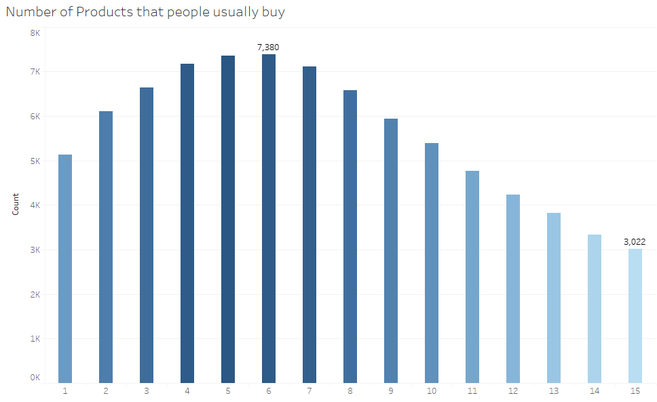
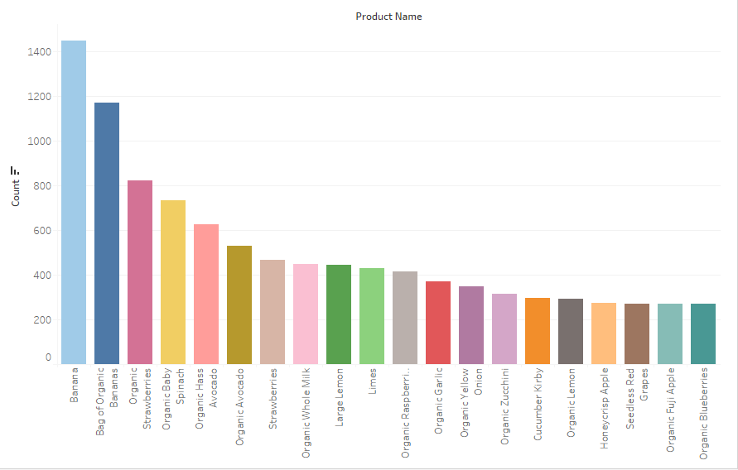
Data Exploration -Number of products that people usually buy
-Popular Products

Slide 5
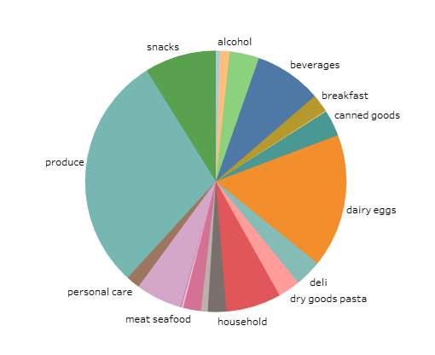
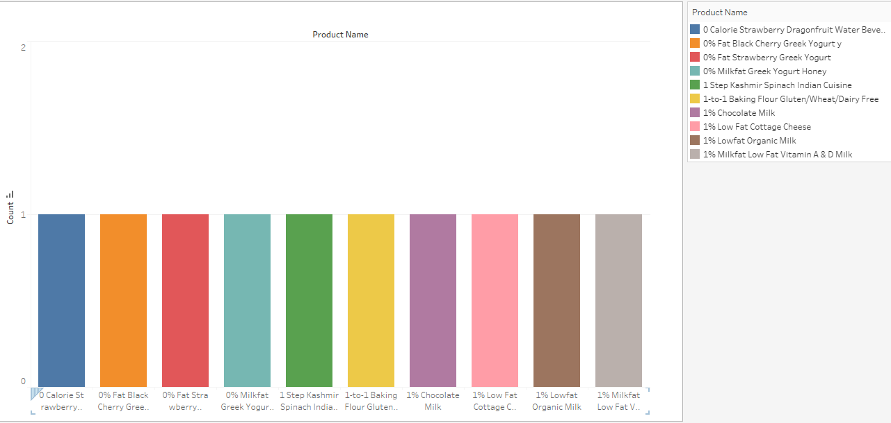
-Department Distribution
-Unpopular Products

Slide 6
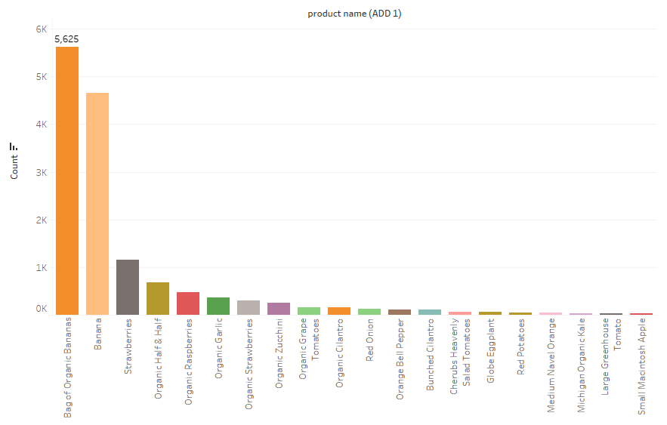
-Popular Product when add to cart is 1

Slide 7
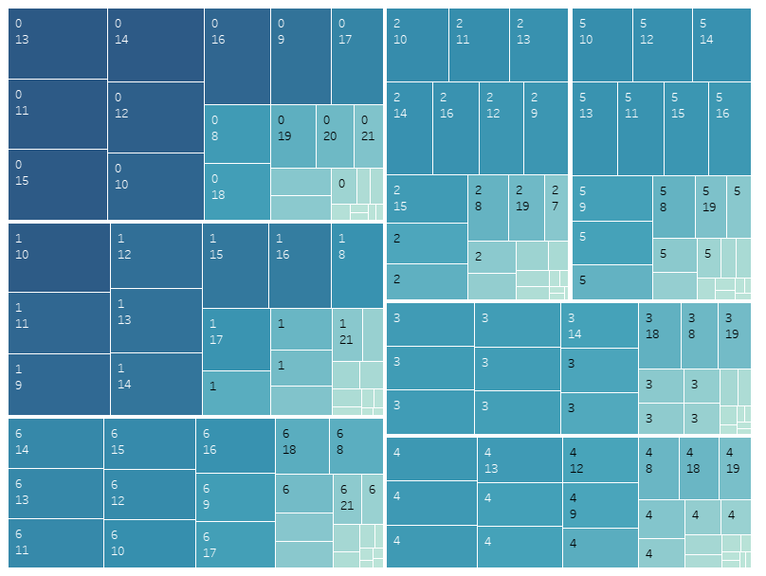
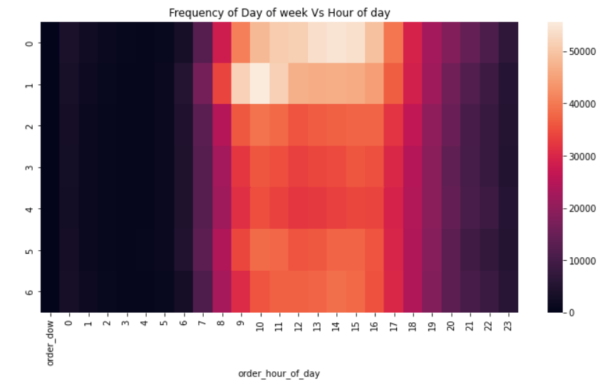
-Heatmap for order dow and hour of time

Slide 8
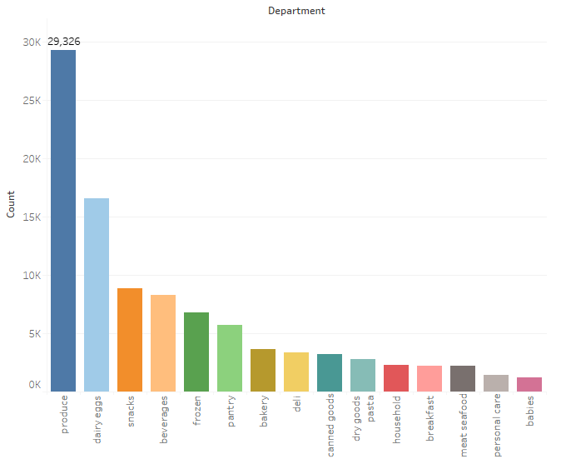
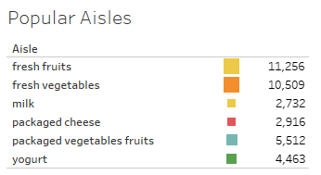
-Popular Departments
-Popular Aisles

Slide 9
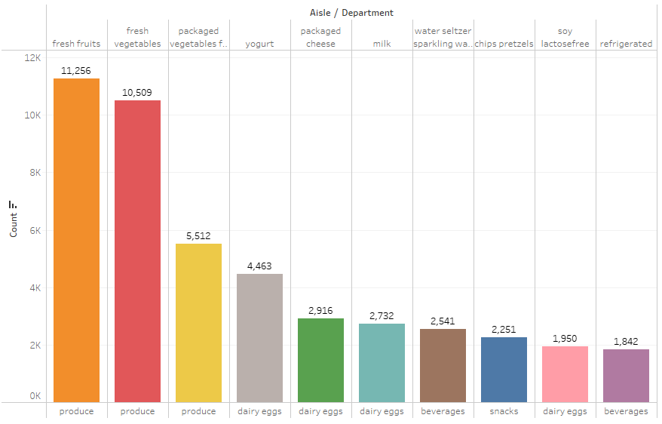
-Best Selling Aisles over All Departments

Slide 10
Data Clustering
Segregate groups with similar traits and assign them into clusters
Entities in each group are comparatively more similar to entities of that group than those of the other groups.
Understand our customers better so that we can market our products to them in a better manner

Slide 11
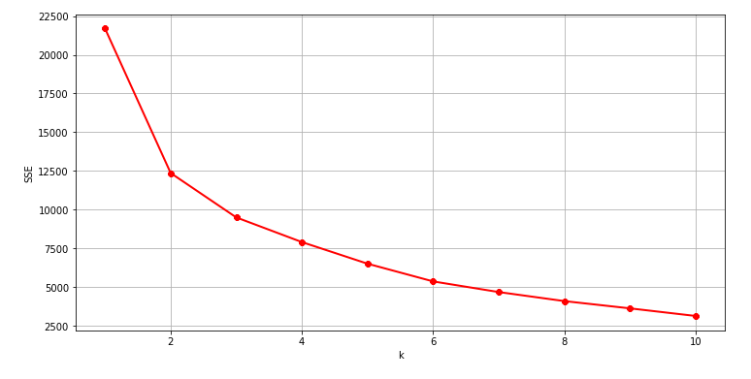
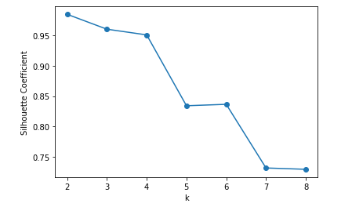
Data Clustering -Method doing data clustering: Elbow Method
- Method doing data clustering:
Silhouette_Coefficient Analysis

Slide 12
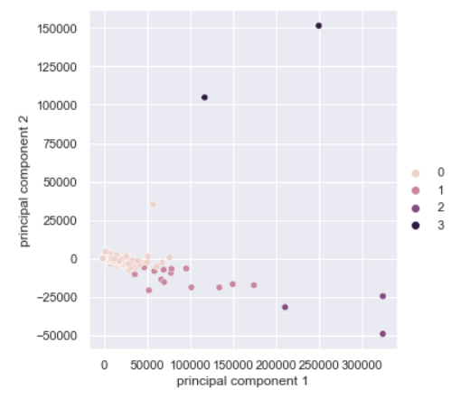
Data Clustering - Principal component analysis (PCA)
Reduces the dimensionality of a multivariate data to two or three principal components
Can be visualized graphically, with minimal loss of information
The customers are divided into four categories with different features

Slide 13
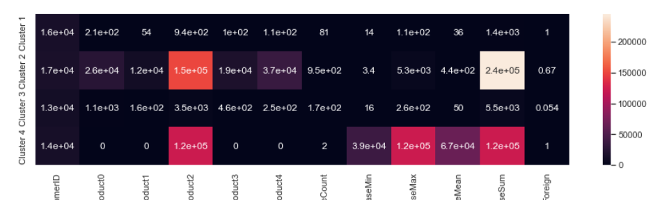
Data Clustering
Heatmap showing different features in each categories
Cluster 1 and 4 are purely composed of UK customers.
Cluster 2 has the largest purchase sum and buys over all 5 products.
Cluster 4 only bought product 2 with only 2 purchase time. It means cluster 4 has bought expensive products

Slide 14
Business Recommendations
Increase storage and price of popular products like banana, bag of organic banana
01
Increase product categories in produce department
02
Ensure popular products’ storage in peak order time (increasing company’s order channels)
03
Reduce the price and storage of unpopular products (sales promotion activity) like 0 calories strawberry dragonfruit water beverage
04
Change product manufacturer of unpopular products.
05

Slide 15
Thank You!

